Slide 1
Decision Tree
(ID3 Algorithm)
By Dr. Ali Saeed

Slide 2
Definition of ID3 Algorithm
It is a classification algorithm that follows a greedy approach by selecting a best attribute that yields maximum Information Gain(IG) or minimum Entropy(H).

Slide 3

Entropy
We need to compute Entropy to use apply ID3 algorithm
Entropy can be computed using following formula
Log ₂ (n) = log ₁₀ (n) / log ₁₀ (2)

Slide 4
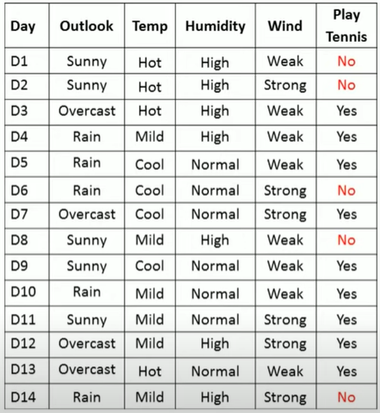
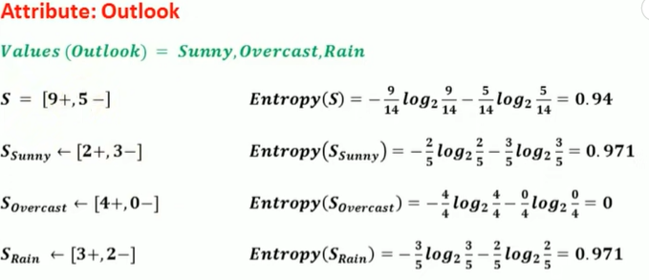
Entropy

Slide 5
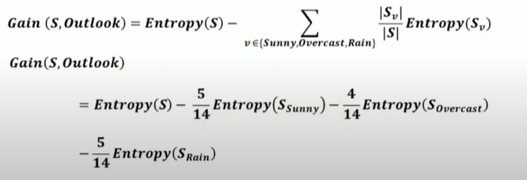

Information Gain
Information Gain

Slide 6
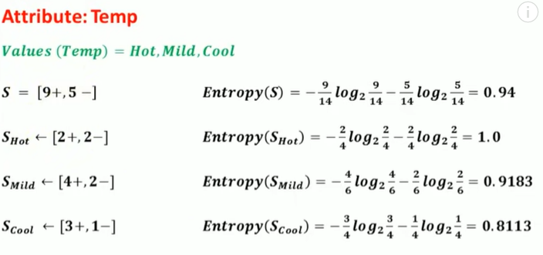
Entropy of Temp

Slide 7
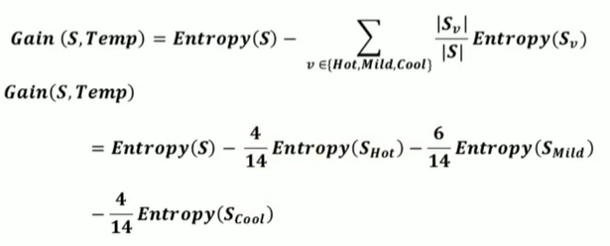

Information Gain of Temp

Slide 8
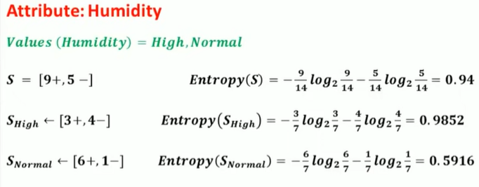
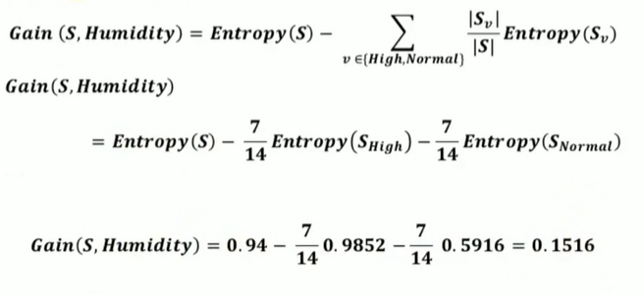
Entropy and Gain of Humidity

Slide 9
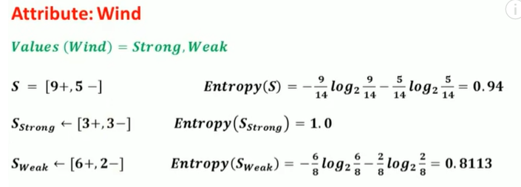
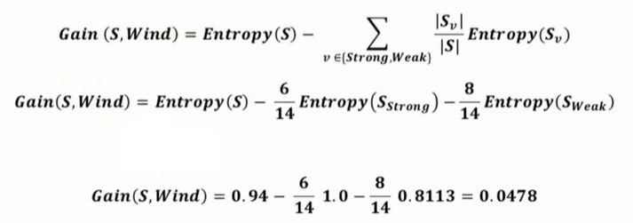
Entropy and Gain of Wind

Slide 10
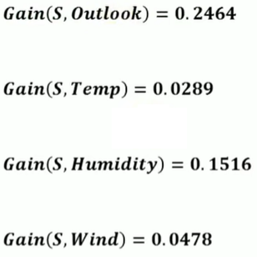
List Information Gain of all attributes
Find which Attribute has maximum Information Gain
Here “Outlook” has maximum information Gain
Then→ Outlook becomes the root node in this case

Slide 11
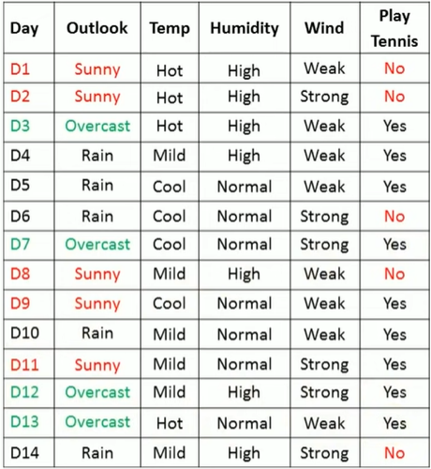
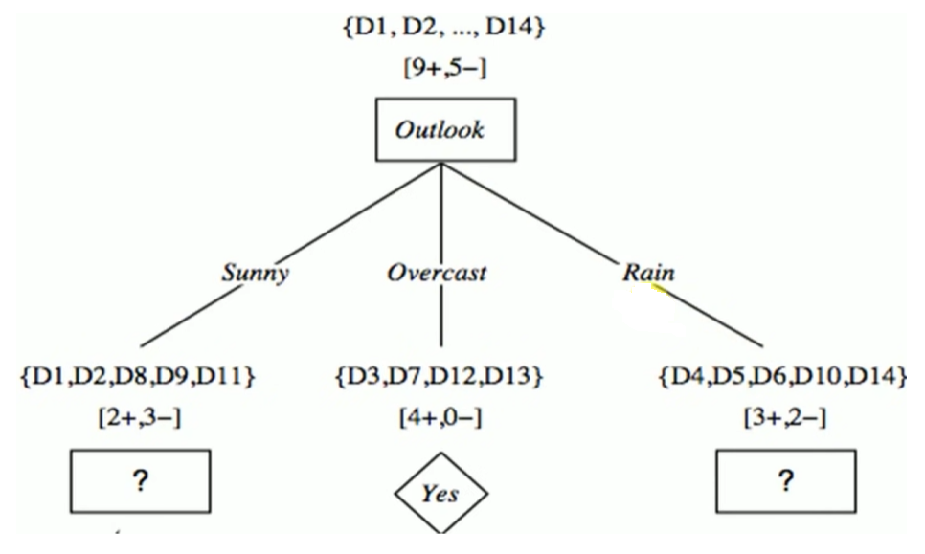
Develop Decision Tree using “Outlook”

Slide 12
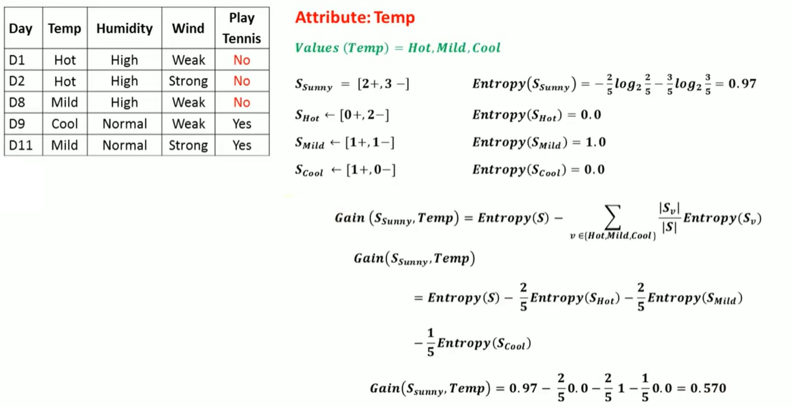
Remaining Dataset

Slide 13
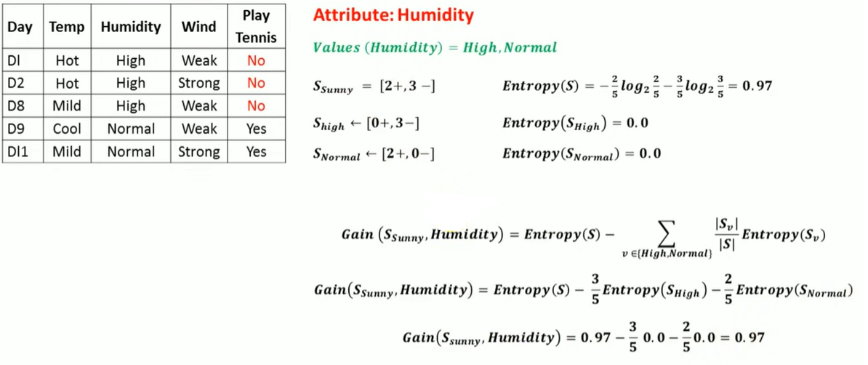
Humidity Attribute

Slide 14
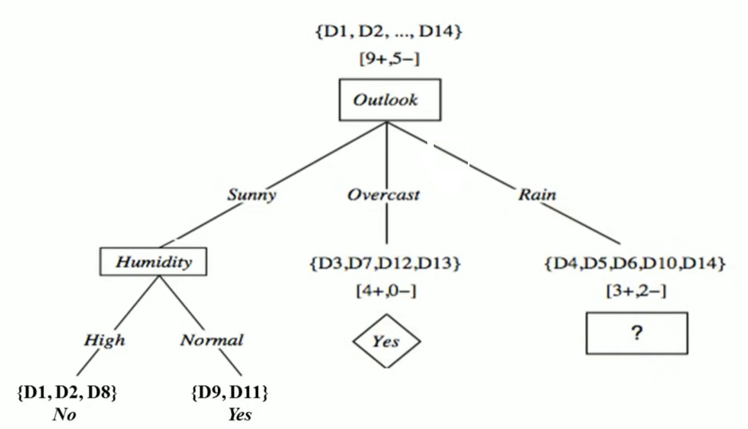
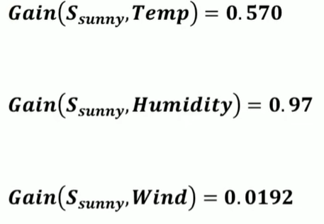
Tree

Slide 15
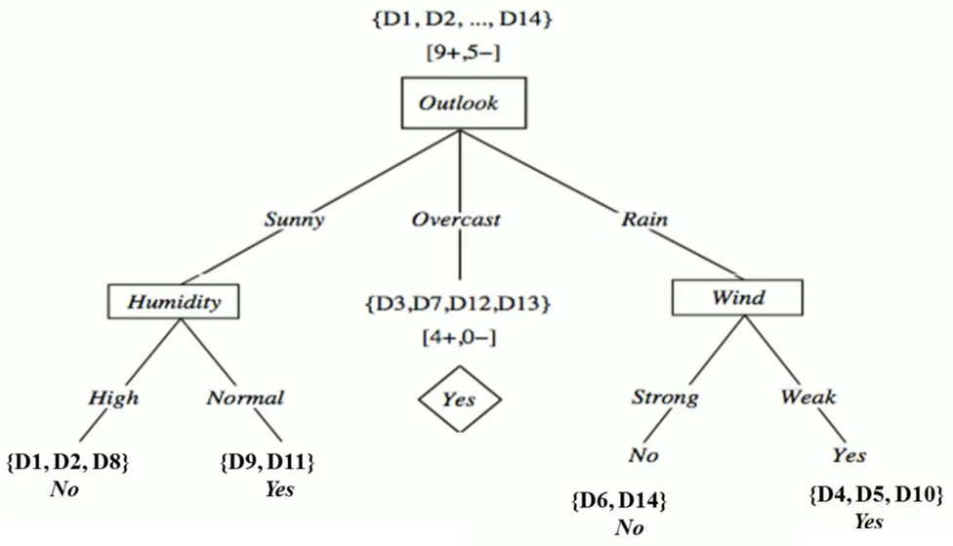
Final Tree

